Slide 1
Programming Skills Workshop
Lesson 6 – Linux

Slide 2
Course Schedule
Tues 22nd – Intro
Wed 23rd – Windows Administration
Thu 24th – Windows Command Line
Wed 30th – Cancelled
Thu 31st – Programming Tips & Tricks
Wed 6th – Programming Tools
Thu 7th – Linux
Wed 13th – More Linux & Languages
Thu 14th – Group Work & More Tools

Slide 3
Course Resources
Course items up on GitHub
https://github.com/kcarta/programming-workshop
These will be updated weekly

Slide 4
Today’s Lesson
Linux
What you’ll learn:
Skills: Installing programs on Linux, building programs from source code.
Knowledge: Linux history and basics.
Values: Linux exists, and it isn’t scary. In fact, it can be pretty awesome.

Slide 5
Linux Installation

Slide 6
Installation!
Go to the course GitHub page and follow the installation instructions
(scroll down a bit to find them)
github.com/kcarta/programming-workshop

Slide 7
Linux Background

Slide 8

What is Linux?
Linux is an operating system kernel. By itself, the Linux kernel is kind of useless.
However, Linux is also the common name for any operating system built on top of the Linux kernel.
What we call “Linux” is actually a gigantic variation of operating systems on an even larger number of devices.

Slide 9

What is Linux? Cont’d
Linux can be found everywhere – from satellites in space to mobile phones to almost 100% of the world’s supercomputers.
There are billions of devices in the world running on Linux, including:
Most* mobile phones and tablets
Most* web servers
Nearly all mainframes and supercomputers
Many embedded devices
(very few) desktop computers

Slide 10
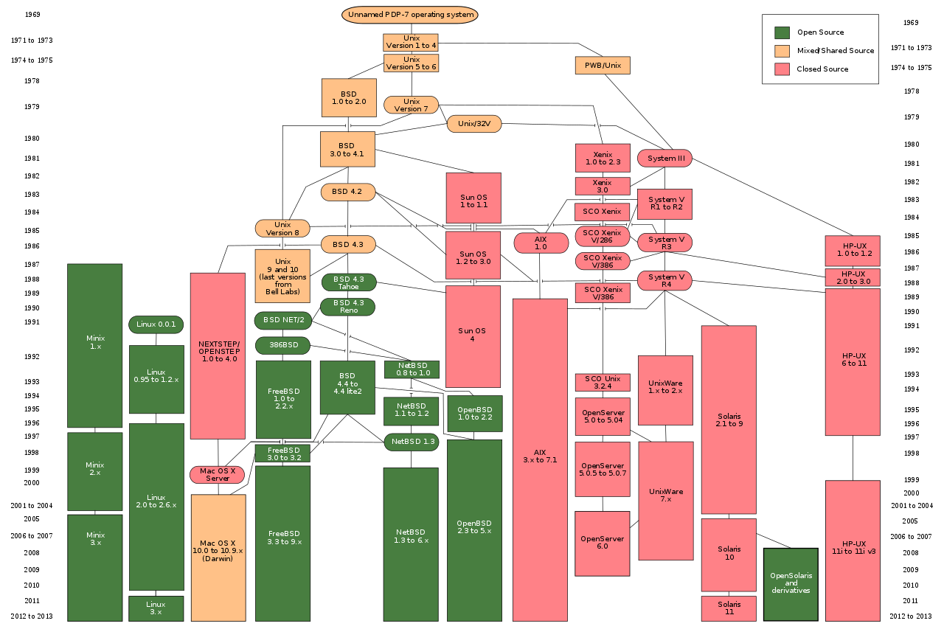
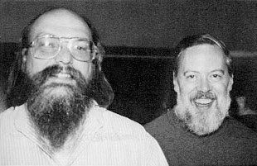
Unix
Unix was an OS developed at AT&T Bell Labs in 1969-1970 by Ken Thompson and Dennis Ritchie
It was later reimplemented in C
Extremely influential, but not freely licensed until much later

Slide 11
Much ado about licenses
Licensing is a big deal in software.
A software license allows software to be legally used and distributed.
Billions of dollars are made by selling licenses, and billions of dollars are won in legal courts over software license disagreements.
Source code is also a big deal. Most software is closed source (secret).
Open source software (OSS) licenses allow for the source code to be read and changed (depending on license). OSS can be sold or given away for free.
The big problem with Unix, in the beginning, was its unclear licensing rules. Nobody wants to touch software with unclear licenses.

Slide 12
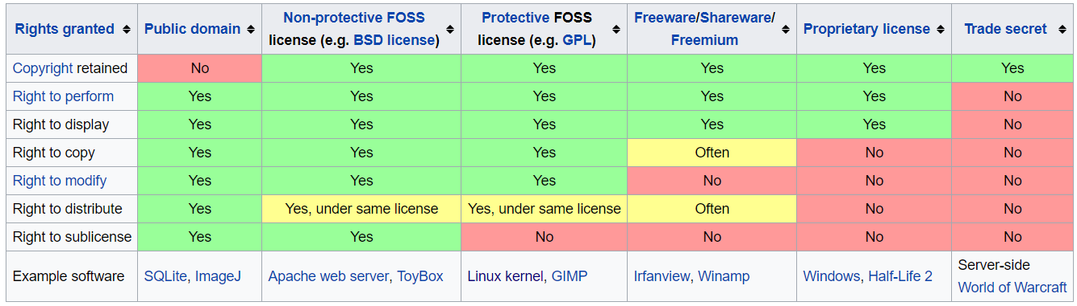
Much ado about licenses

Slide 13

Linus and Linux
Linus Torvalds developed the Linux kernel in 1991 as a student project.
He wanted to make a Unix-like kernel that was freely licensed.
Linux quickly picked up attention amongst hobbyists and academics, and the rest is history.
Linus Torvalds still leads Linux development today.
Linus Torvalds, an incorrigible git

Slide 14

GNU
In the 1980s, free software pioneer Richard Stallman created the GNU Project, to make a freely licensed Unix-compatible operating system.
The GNU project built many Unix-like tools, but failed to produce an operating system kernel.
When the Linux kernel appeared in the 1990s, it and the GNU project tools were a match made in heaven.
Some argue that Linux is more accurately GNU/Linux

Slide 15
Linux Distributions
Linux comes in many flavors, also known as distributions.
The system built on top of the Linux kernel determines the flavor.
There are thousands of Linux distros for every use case imaginable.
Many distributions are widely used, including:
Debian, for web servers
Ubuntu (built on Debian), for web servers and private use
Arch Linux for general use
Fedora for developers, Red Hat for enterprise
Mint
Android
Kali

Slide 16
Why Linux?
You already know and use Windows. So why learn Linux too?
Linux is worth learning, because Linux is:
Everywhere
Seriously - everywhere computers exist, Linux is used
Linux comes in so many shapes and sizes, one is bound to match your tastes
It’s so common, that not knowing it is a problem
Easy
Linux is based on simple and traditional software concepts
Any question you can ever have, someone has answered on the internet
Built for Developers
Linux is endlessly configurable (sometimes even too much)
Many of the tools and platforms you want to use, run best on Linux
Free (in more ways than money)

Slide 17
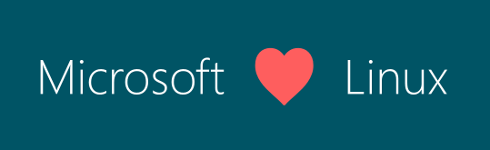
Windows and Linux
For years, Microsoft waged war on Linux.
Recently, Microsoft shifted from selling products to selling services.
With this new worldview, Microsoft started “loving Linux”.
Microsoft now provides Linux cloud services, and is even actively integrating Linux tools into Windows itself.

Slide 18
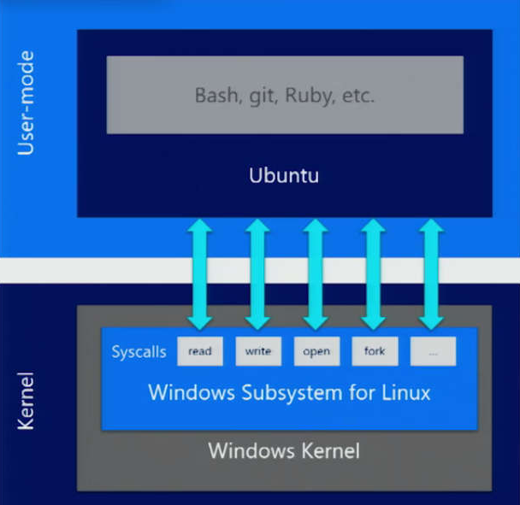
Windows Subsystem for Linux
With a new Linux-loving approach, Microsoft has found new ways to integrate Linux into Windows itself.
The Windows Subsystem for Linux allows a Linux distribution to run natively inside of Windows.
This is a big deal.

Slide 19
Linux Introduction

Slide 20
Navigating on the Linux Terminal
> cd [target]
Changes directory to the target.
If no target provided, goes to your user home directory.
> pwd
Tells you where you are.
> ls
Lists all folders and files in your current directory.
Same as dir from windows.

Slide 21
File manipulation on the Linux Terminal
To create a directory:
> mkdir [directoryName]
To remove a file:
> rm [fileName]
To remove a directory and all its files (dangerous!!!):
> rm –rf [directoryName]

Slide 22
Linux File System
Everything is a file
Even your RAM memory or a serial port are files
Each file or directory has access privileges that dictate who can read, write and execute them

Slide 23
Linux File Structure
/ - is the root directory of the file system
~ - is your home directory. Its an alias for /home/<username>
To see the full hierarchy run man hier or read wikipeida page about FHS
Interesting files
/dev/null – everything written here is imediatly lost
/bin – contains all programs used by user or system during run
/tmp – temporary directory that may be randomly erased
/media – this is where devices get mounted (USB, DVD,…)

Slide 24
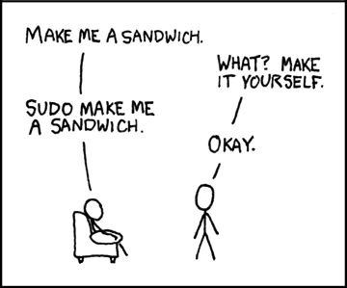
Root & Privileges
Root is a Unix term for SuperUser.
(Same as administrator in Windows).
Root can do anything and change anything on a computer (including breaking it!)
To execute program as root you can:
Use the sudo prefix before a command:
> sudo [command]
Login with the root account

Slide 25
Using bash
bash is the command line interface most often used with Linux.
It has a ton of features, enough for a standalone course
The important features are also in the Windows command prompt:
Tab completion
History
Shell scripts

Slide 26
background
When a program is push program to background with Ctrl+Z
Program can be returned to the foreground with fg

Slide 27
Installing and Building Programs

Slide 28
APT
Installing programs on Ubuntu is much easier than on Windows.
APT is a tool for installing and managing programs.
APT can:
Install any program in its vast repository
Remove any program you have installed
Update programs
Update your OS (not to new major versions)

Slide 29
Updating & Upgrading with Apt
APT is easy to use.
The apt-get command is what you’ll use day-to-day.
To update the APT repository (extremely important to do often!):
> sudo apt-get update
To install something from the repository (try with the Tab key!):
> sudo apt-get install [name]
To update programs on your computer:
> sudo apt-get upgrade

Slide 30
Building from Source
Open source software is the most important thing about the Linux project.
But what does that mean in practice?
Imagine if you could:
- Tweak a video game to be more fun
Remove annoying features from a program
Use an existing program as a base to make something completely new
Open source software gives you these opportunities!
* But at the cost of knowing how to build software from its source code :o

Slide 31
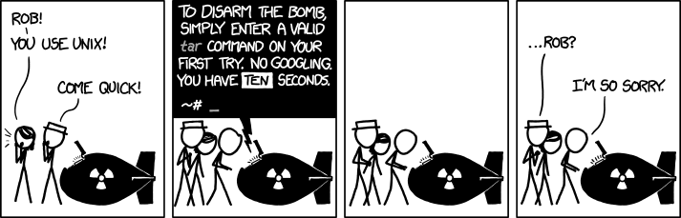
Tar
In the Linux world, most source code comes wrapped up in a tarball.
This is just a fancy name for a compressed file.
To decompress a tarball, the tar utility is used:
> tar –xzvf [tarball-path]

Slide 32
wget
To download files off the web, the wget tool is used.
It is very simple to use.
> wget [url]
Try it with random websites and see what happens!

Slide 33
make
When you’ve downloaded and extracted the source code for a program, all that’s left is to build it (and optionally install it).
Important files to look for are README and INSTALL. These are instructions for how to build the code – read and follow these!
Usually, the INSTALL instructions require you to use apt-get to install dependencies first.
The make tool uses a Makefile to build and install a program for you.

Slide 34
Walkthrough: Build from source
Using wget, tar and make, let’s build us a program!
Use wget to download the file at: github.com/fph/bastet/archive/0.43.2.tar.gz
Extract the downloaded .tar file with tar –xzvf
Enter the source code directory with cd
Install the dependencies listed in INSTALL using apt-get install
Install build-essential too
Run make and watch the program build
Run the program! (type ./bastet)

Slide 35
Linux Tools

Slide 36
man
Displays manual for a command on the screen
man [command]
man hier
Prints the file structure of the os

Slide 37
cat
Concatenates files and print on the standard output
> cat something.txt
-> prints the text file to output stream

Slide 38
less
less is a better more
Prints large text to screen
Allows to scrolling in both directions

Slide 39
history
Displays previous used commands in this session

Slide 40
grep
Searches and displays lines containing specified text
Very useful with the | pipe

Slide 41
ps
Lists all currently running processes
Useful in combination with grep
> ps | grep bash

Slide 42
who and whoami
who
Lists all currently logged on users
Arguments “am i” or “mom likes” are same as -u
whoami
Prints the current user

Slide 43
touch
Updates the last used time on a file or directory
If the file doesn’t exist, it creates a new one
Most of the time used to create files

Slide 44
whatis
Displays a single like manual description
Like man, but with a single line one

Slide 45
nano
Simplest text editor on Linux
Equivalent of notepad on windows
> nano [filename]
Ctrl + X and follow on screen instructions to save and exit file

Slide 46
And many many more!

Slide 47
Now for a little adventure!
Terminus
A text-based adventure game to learn about CLI interfaces
web.mit.edu/mprat/Public/web/Terminus/Web/main.html

